Slide 1

Raspberry Pi
An introduction

Slide 2
Introduction
The Raspberry Pi is a credit-card sized computer
It can be plugged into your TV and a keyboard, and can be used for many of the things that your average desktop does - spreadsheets, word-processing, games and it also plays high-definition video.

Slide 3
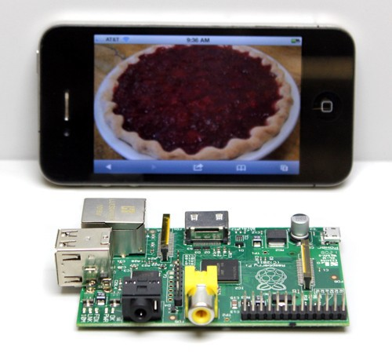
size
They measure approximately
9cm x 5.5cm

Slide 4
History
The Raspberry Pi is the work of the Raspberry Pi Foundation, a charitable organization.
It's supported by the University of Cambridge,Computer Laboratory and tech firm Broadcomm

Slide 5
What is Raspberry Pi?
The Raspberry Pi is a fully featured micro- computer squashed onto a circuit board measuring approximately 9cm x 5.5cm.

Slide 6
Features
Ultra low-cost (Model A $25, Model B $35)
Ultra low-power ~1W
Credit-card sized, fan-less, instant start-up
Complete easy-to-program computer
Provide a fun environment for experimenting with programming and electronics
Inexpensive, simple, open and easy to maintain computer for schools
Fun computer for children to experiment with at home(programming, robotics, etc...)

Slide 7
Technology
The Raspberry Pi has a Broadcom BCM2835 system on a chip (SoC),which includes an ARM1176JZF-S 700 MHz processor
Video Core IV GPU
originally shipped with 256 megabytes of RAM, later upgraded to 512MB.
It does not include a built-in hard disk , but uses an SD card for booting and long-term storage.

Slide 8
Hardware
10/100 BaseT Ethernet socket
HDMI socket
USB 2.0 socket
RCA video socket
SD card socket
Powered from microUSB socket
3.5mm audio out jack
Header footprint for camera connection

Slide 9
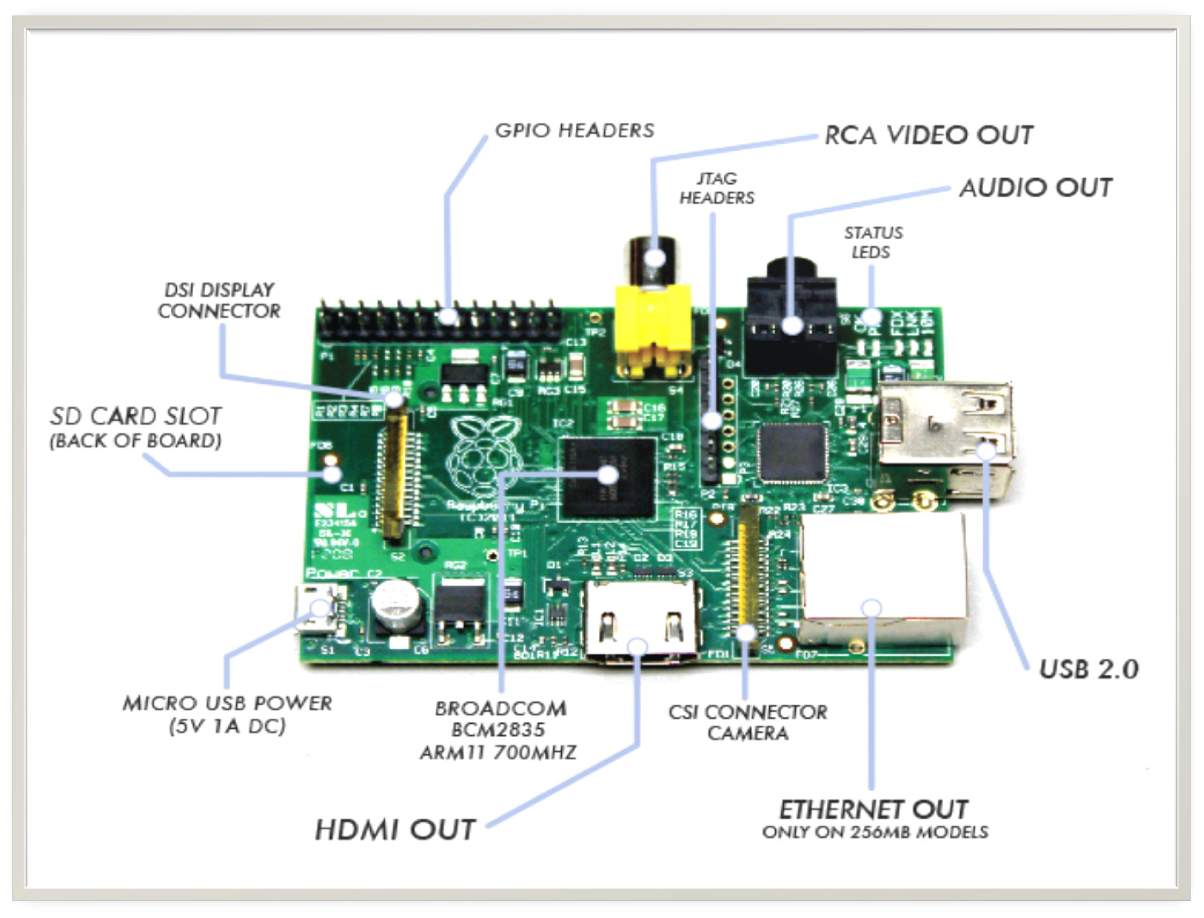

Slide 10
Operating System
Linux on a bootable SD card
  Fedora
  Raspbian
  Debian
  ArchLinux ARM

Slide 11
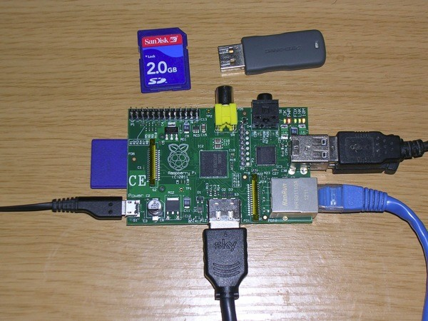
Connections

Slide 12
Programming
By default, supporting Python as the educational language.
Any language which will compile for ARMv6 can be used with the Raspberry Pi.

Slide 13
Price (as of 2020)
Model A - $ 25
Model B - $ 35
Why so cheap ?
  SoC - System on a chip, a computer on a single low voltage chip
  Linux OS

Slide 14
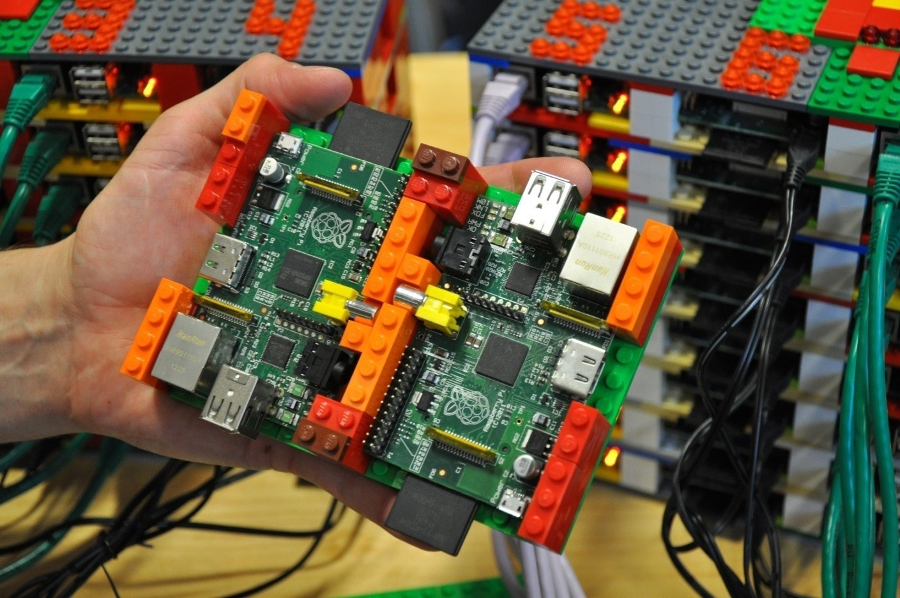
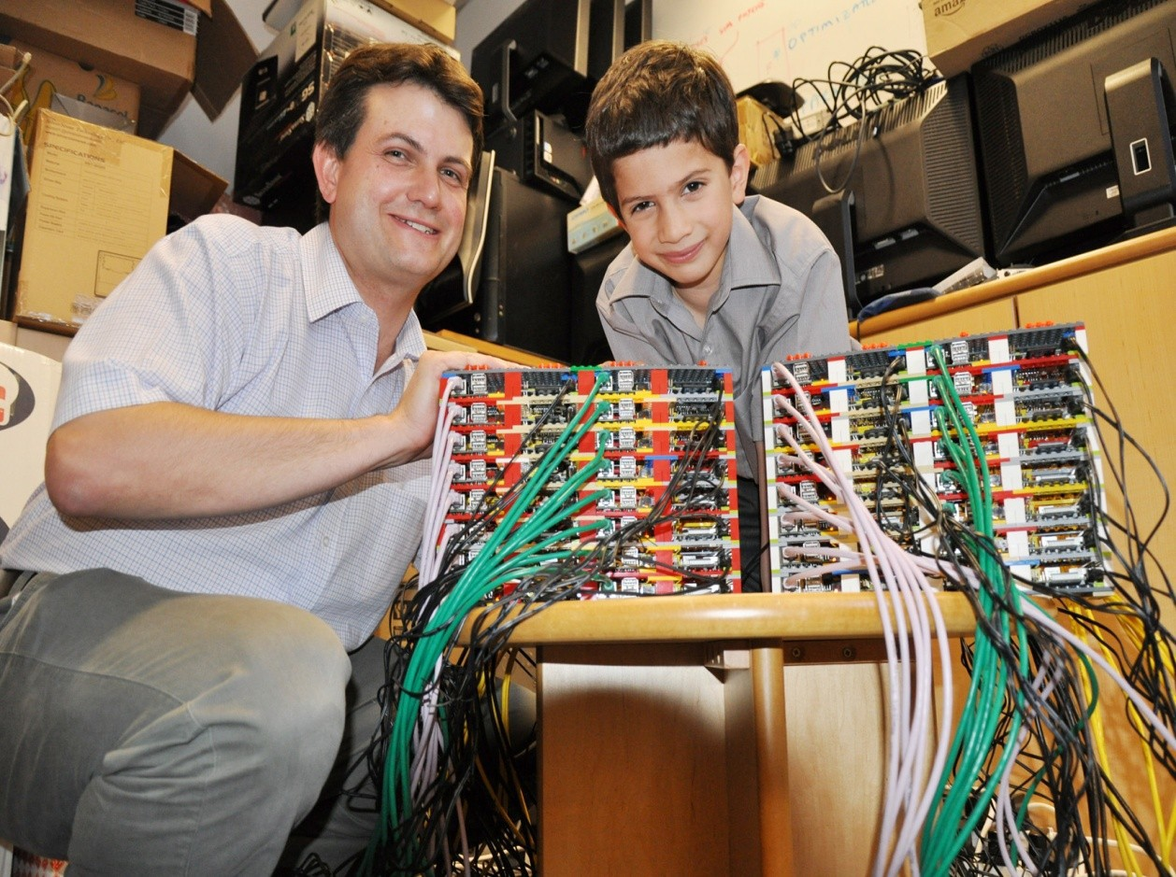
Applications
Can be used for making super computers

Slide 15
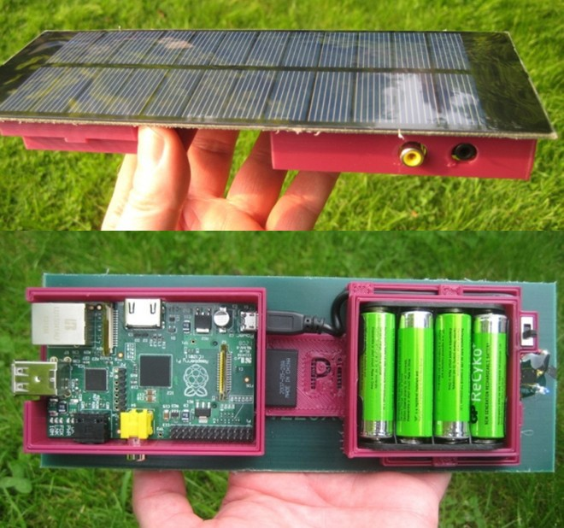
Applications
Solar Raspberry Pi Power Pack

Slide 16
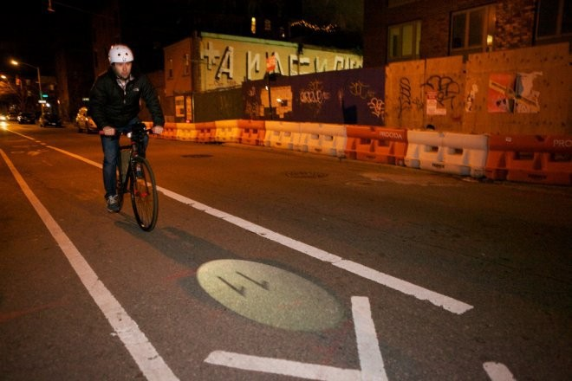
Applications
Voice-Activated Coffee Machine
Raspberry Pi Dynamic Bike Headlight Prototype

Slide 17
Applications
It can make your Old TV in to a smart TV. (You can play Videos, 3D Games, Music, Browse Internet and much more.
Raspberry Pi can Act as Full HD 1080p Media Player.
Its a Mini Computer which just cost Rs.2,350/-
You can connect a Monitor, Keyboard and Mouse and use it as a normal computer.
Its Graphics Capabilities is better than Apple Products.

Slide 18
Disadvantages
It does not have a Hard Disk associated with it for permanent storage pf files,we have to connect one externally or have to use SD card for the purpose.
The RAM is a POP package on top of the SoC, so it’s not removable or swappable.
There is no Real time clock associated with the board. Adding an RTC is expensive. You can add one yourself using the GPIO pins.

Slide 19
Future Developments
Tablet version
Interesting low-cost screen technologies emerging
Brambles! (Networks of Raspberries)
Exploit process scaling and keep price constant:
8 cores, improved GPU, 8GB main memory
WiFi, camera, matchbox sized case
holographic laser projector, virtual keyboard
FPGA logic on main SoC, high speed links, ….
– < $25

Slide 20
References
Electronics For You, November 2012, Page 18
http://en.wikipedia.org/wiki/Raspberry_Pi
http://www.raspberrypi.org
http://www.element14.com/community/groups/raspberry-pi

